Slide 1
City of Sparks
Strategic Plan Update
Mike Kazmierski, President and CEO
March 11, 2019

Slide 2
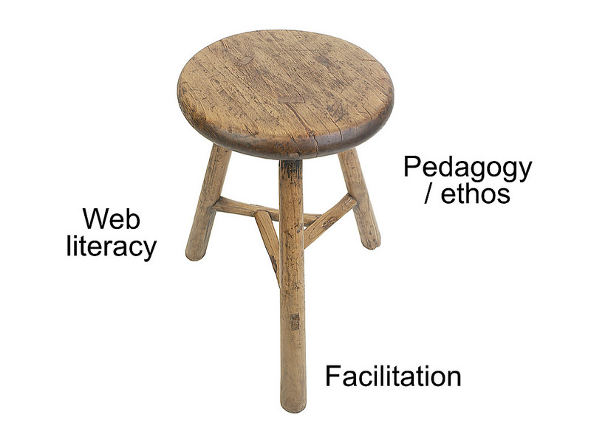



EDAWN’s Strategic Plan
Workforce Development
Retention / Expansion
Attraction
Community Development
Entrepreneurial
/ Startup Growth
2
Notes:
I know most of your have seen this before but this is our strategic plan in a nutshell
We have three areas of focus
The need for quality workforce in all three legs of our economic development stool makes workforce development the seat of the stool.
While community development, the foundation upon which the entire economic development effort rests must be addressed for the long term success of the program.

Slide 3

EDAWN's Focus – The Evolution Continues
EDAWN's Efforts %
Attraction
Retention Workforce
Entrepreneurial Jobs
Entrepreneurial & Technology Attraction
3
Notes:
Here is how EDAWN is evolving
1. Higher paying jobs and HQs in our attraction efforts
2. workforce development in our retention efforts
3. and in mentoring and connections for our entrepreneurial ecosystem
2018 - This year we remain balanced with an emphasis on the attraction of high wage and technology jobs which will be done in a cooperative way by both the Attraction and Entrepreneurial teams
2020 - Over the next few years we will put even more emphasis on the attraction of these high wage technology jobs

Slide 4
Considerations For Plan Update
Plans Every 3-5 years
Progress In Transition To Quality Jobs
Future Job Needs For The Community
Industry Fit For The Future
Growth Projections
Changes In National Economy
Notes:
John Restrepo, an economist that produced the initial report lead the effort to update it.
The new EPIC report will go out this afternoon in the EDAWN Executive update if you want to dig into it.

Slide 5
7 Year Plan For Technology
2012- 2018 - Phase 1. Build A Technology Base
Advanced Manufacturing
Data Centers
Entrepreneurial
Growth
Improve Branding And Feel Of Community
Increase STEAM Focus In Education
2018-2025 - Phase 2. Build On The Base With A Focus On Attracting: Blockchain; Internet Of Things; Biotech, Fintech & B2B Software
Area Development Magazine – Q4 / 2018
Nevada #1 + 20% In Manufacturing Jobs
Notes:
I Think Most of you know that technology companies didn’t suddenly decide to move to Reno
If we look back at our plan to become a location for technology you can see we started first to build a base.
Now that we are on the radar as an acceptable place for technology we can really focus on the kinds of tech companies that are the best fit for our community and are growing.
We can not abandon our efforts to be a hub for advanced manufacturing as that provides a good mix of jobs and maintains the need for technology in Robotics, AI and software.
While Nevada is Number one for the growth of Manufacturing in the Country we all know that most of that growth is here in the north.

Slide 6
Key EPIC Participants
City of Reno
City of Sparks
City of Fernley
Washoe County
Storey County
EDAWN
NV Energy
TMCC
RTC
WCSD
GOED
Truckee Meadows Regional Planning Agency
Center of Regional Studies
State Demographer
Reno Tahoe Airport Auth
NV Dept of Employment, Training and Rehabilitation
Truckee Meadows Water
University of Nevada
Western Nevada Development District
Notes:
Many of your may recall that when we released the first economic planning indicators committee report 4 years ago the feeling was that we were way too optimistic.
As we projected more than 50,000 new jobs in the region in just 5 years.
We are now 4 years later So it was time for an update and I want to thank these agencies for their input and support with the update

Slide 7
EPIC 2 Report - Results
Data Input From 5 Sources
Addresses 5 County Region Around TRI
Forecast:
A Slowing From 3% to 2.4% on Jobs
An Increase From 1.36% to 1.68% on Population
Anticipates:
A Mild Recession
Some Adverse Impacts From Housing Shortage
5 Year Forecast
Jobs 51,585
Population 54,470
Notes:
Going forward for the next 5 years we project continued growth at a robust pace but actually slowing a bit from what we have experienced in the last few years.
We did factor in a mild recession and some impact from our shortage of affordable housing

Slide 8
EPIC Employment Actual Vs Projected
In 1,000’s
Actual
Notes:
You can see what this looks like on a chart.
Green is the Actual Job Count
Orange is the Projections from EPIC 1 and Red is where we think we will be in the next 56 years.
We are still moving along at a brisk pace.

Slide 9



The 4th Industrial Revolution
Robots Could Kill 73 Million U.S. Jobs By 2030
In The U.S., 39 Million To 73 Million Jobs Could Be Destroyed
About 20 Million Can Be Easily Shifted Into Similar Occupations
However, The Others, 1/3rd Of The U.S. Workforce, Will Need To Be Retrained For Entirely New Occupations
Notes:
The most important thing you can take away from this presentation is the fact that
we are in the 4th industrial revolution and that
this is happening at an unprecedented speed.
The job world will be very different in just a decade. Think back 10 years ago and acknowledge how fast those 10 years have gone by.
In less than 10 years the jobs you have now will either be gone or dramatically changed.

Slide 10
The 4th Industrial Revolution*
By 2022 Companies Expect:
Adoption Of Big Data Analytics, Internet Of Things, & Machine Learning
  30% Plan Robot Adoption
  50% To Reduce Workforce
  68% Growth In New Professions - 27% Of All Jobs
  54% Of All Employees Will Require Re / Upskilling
Drivers Of Change:
High-Speed Internet
AI
Big Data Analytics
Cloud Technology
*According To The World Economic Forum
Notes:
In just 4 years – 27% of all jobs will be new professions, like, Block Chain or Artificial Intelligence
Most of us will require some sort of retraining!

Slide 11
Brookings – Automation & AI
Tasks More Vulnerable To Automation Involve Information Collection & Processing, Or Physical Activities
10 States Where Robots Are More Likely To Steal Human Jobs
1. Nevada — With retail and gaming SmartAsset estimates nearly three in five are at risk of automation.
Such Activities Are Found In Many Middle Skill Roles:
  Office Administration
  Construction, Maintenance, & Repair
  Production /Transportation
  Agricultural Activities
Notes:
https://futurism.com/the-byte/automation-robot-steal-jobs-states
Here are some of the jobs most vulnerable to Artificial Intellegence and Automation
Interesting that Nevada as a state is considered the most vulnerable – 3 of every 5 jobs in the state at risk

Slide 12
Economic Development Impact
McKinsey & Company – Global Institute
A very large number of people need to shift occupational categories or learn new skills ….On a scale not seen since the early 1990’s.
With sufficient economic growth, innovation and investment there can be enough new jobs created to off set the losses.
**Economic growth is essential for jobs creation. Stronger growth and innovation will generate more labor demand.
Notes:
It is important to recognize that economic development is more important than ever as the jobs of the future will not just happen to wander into our community.
We need to embrace this change and even lead it - with the companies we attract and grow.
As well as preparing our workforce in and out of school, for the next generation of jobs.

Slide 13

EDAWN Strategic Plan Update
Consider Impacts Of 4th Industrial Revolution
Target Growth (Transformative) Technologies That Fit Well With Our Current Economy
Update To Address:
Attraction Efforts - Emphasis On Technology
Entrepreneurial Growth & Attraction
Workforce Development & Attraction
Community Development
Notes:
So how does all of this play into our updated strategic plan.
Target the transformative technologies and look at these four areas to change the most

Slide 14

Attraction & Entrepreneurship
Strategic Focus:
  High Wage Jobs Especially HQs
  Improve Perceptions Of Region
  Attract Technology Co’s & Entrepreneurs In Focus Sectors
  Build Region’s Tech Talent Pool
  Strengthen Bay Area Connection
  Enhance Ecosystem & Increase Capital
  Technology Sector Focus:
  Blockchain
  IoT
  Bio Tech
  Fintech
  Software
  (B2B)
Notes:
We are already doing much of this now but will work more aggressively to engage with the Bay area
Advanced Manufacturing includes Robotics and software development
You can see our technology targets are in the transformative technologies that best fit our community strengths

Slide 15
Workforce Development
Strategic Focus:
Workforce Programs In K-16 Education For Target Sector To Meet Current And Targeted Primary Employers’ Needs
Work-Based Learning Partnerships – Internships!!!
Connect Employers, Educational Institutions & Talent
Workforce Attraction
Notes:
The updates for workforce development include the changes we need to make to prepare our workforce for the coming changes.
Unlike when we were at 14% unemployment, talent attraction is more important than ever.

Slide 16
Community Development
Strategic Focus:
Advocate For Infrastructure Upgrades Needed To Accommodate Growth Including:
    Workforce / Affordable Housing
    Transportation (Roads, Rail And Transit)
    Wastewater Treatment - Effluent
    Flood Control
Support Community Efforts To:
    Improve Downtown, Trails, Arts & Culture
    Address Homelessness
Notes:
(Reference Video) That’s want we need our kids to get involved in - First Robotics and Vex Robotics are two major programs that are engaged in the district
Of course we need a business friendly community that can accommodate the coming growth.
These are some of the issues we will advocate for as they directly impact on our ability to continue our economic success.
The better and more receptive our community is to talent, the more successful we will be in the new economy.

Slide 17
Regional Public / Private Partners
City of Reno | UNR | State Offices
City of Sparks | TMCC / WNC | Nevada JobConnect
City of Fernley | DRI | Nevadaworks
Washoe County | The Chamber | NNDA
Storey County | NCET | NV Energy
Washoe County School District | Nevada Museum of Art | Reno-Tahoe Airport Authority
GOED | RTC | Investors
DETR | RSCVA | Many Others !
17
Notes:
We can’t do what we do without a lot of help. As you have heard before, Economic Development is a team sport and we are proud to be a part of a winning team.
A special thanks to our elected officials and their amazing staffs.
Let’s give all of our partners –a round of applause!

Slide 18
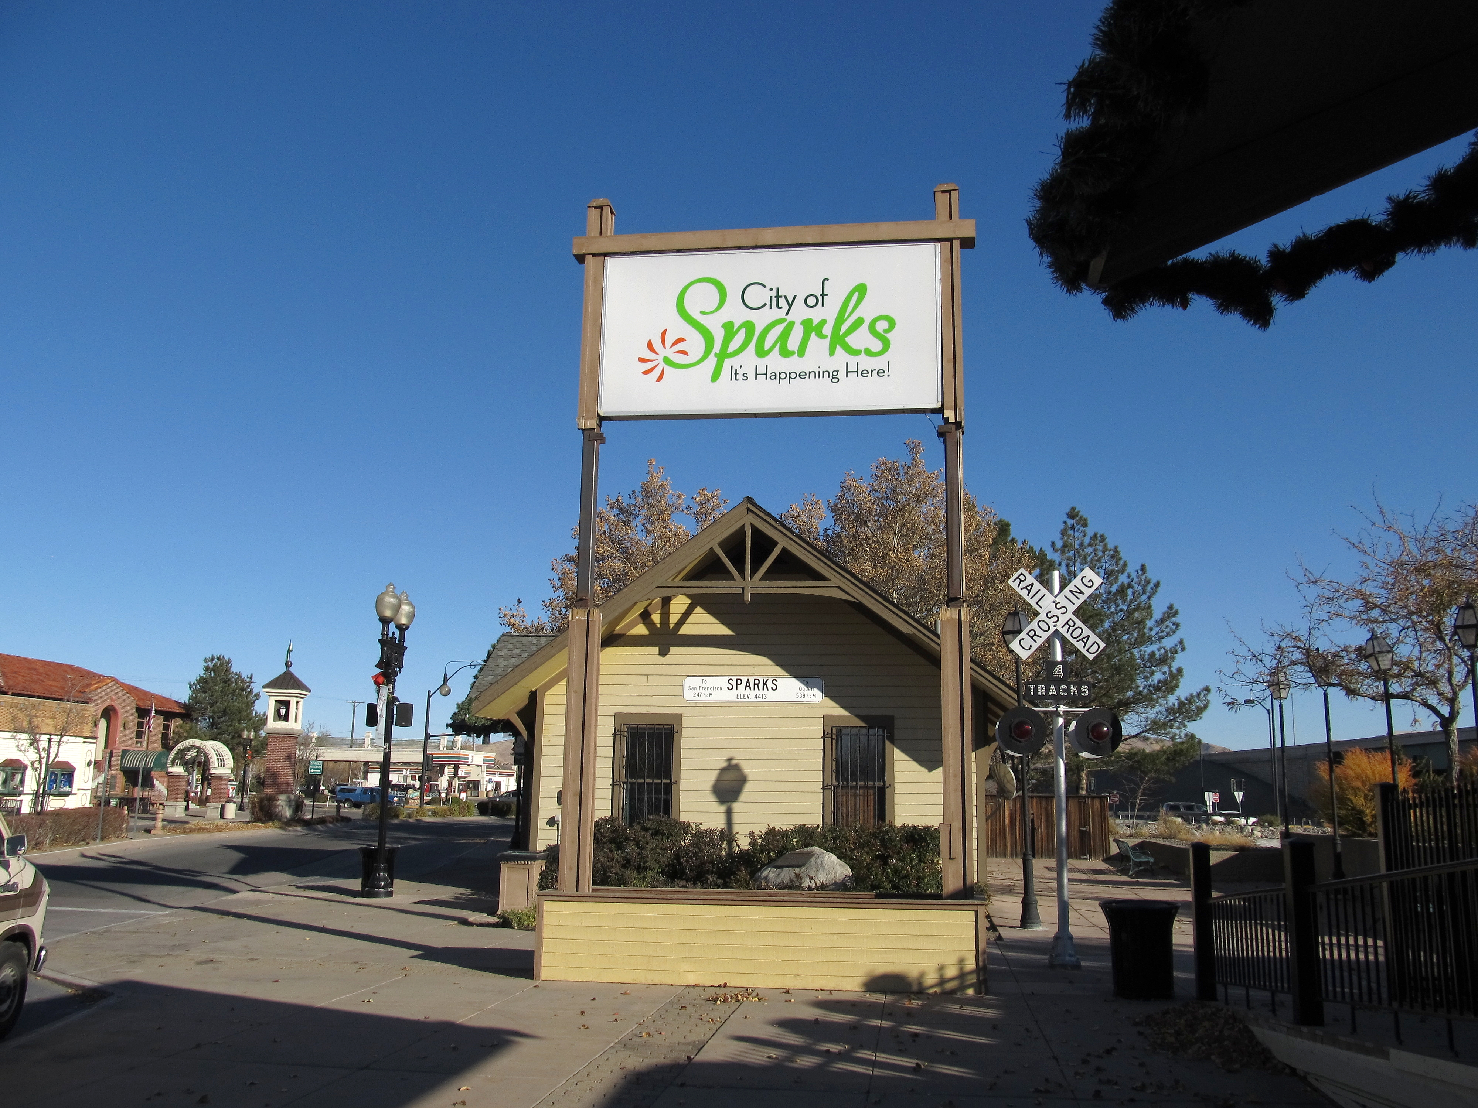
Questions?

